Slide 1

APP SERVICE

Slide 2
APP SERVICE
Azure App Service is an HTTP-based service for hosting web applications, REST APIs, and mobile back ends. You can develop in your favorite language, be it .NET, .NET Core, Java, Ruby, Node.js, PHP, or Python.
Applications run and scale with ease on both Windows and Linux-based environments.

Slide 3

Why use App Service?
Azure App Service is a fully managed platform as a service (PaaS) offering for developers.
Key Features :
Multiple languages and frameworks
Managed production environment
DevOps optimization
Global scale with high availability
Containerization and Docker
Security and compliance
Serverless code

Slide 4
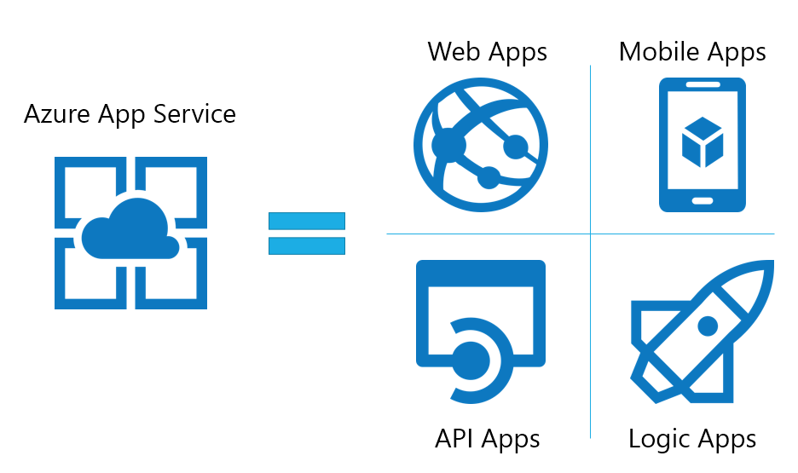
App Types
Web Apps : Quickly create and deploy mission critical web apps that scale with your business.
Mobile Apps : Engage employees, partners and customers on any device at any time.
API Apps : Easily build and consume cloud APIs
Logic Apps : Automate the access and use of data across clouds without writing code.

Slide 5
APP SERVICE PLANS
An app service always runs in an App Service plan. An App Service plan defines a set of compute resources for a web app to run. These compute resources are analogous to the se4rver farm in conventional web hosting. One or more apps can be configured to run on the same computing resources (or in the same App Service plan).
When you create an App Service plan in a certain region (for example, West Europe), a set of compute resources is created for that plan in that region. Whatever apps you put into this App Service plan run on these compute resources as defined by your App Service plan.

Slide 6
Operating System (Windows, Linux)
Region (West US, East US, etc.)
Number of VM instances
Size of VM instances (Small, Medium, Large)
Pricing tier (Free, Shared, Basic, Standard, Premium, PremiumV2, PremiumV3, Isolated, IsolatedV2)
Each App Service plan defines:

Slide 7
Thank You

